Slide 1
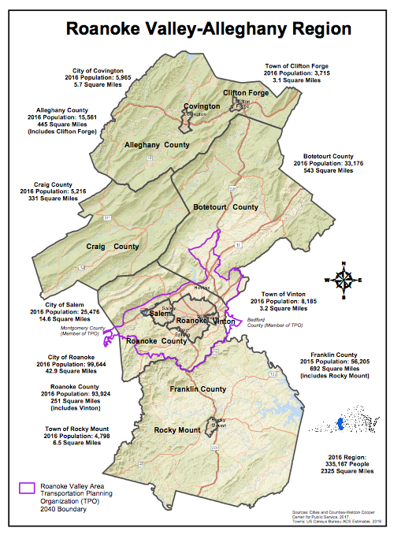
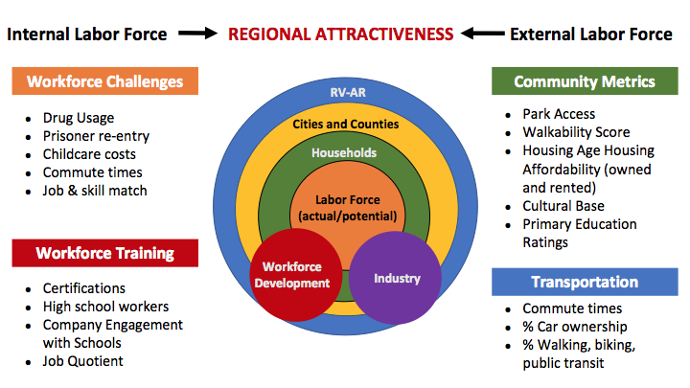
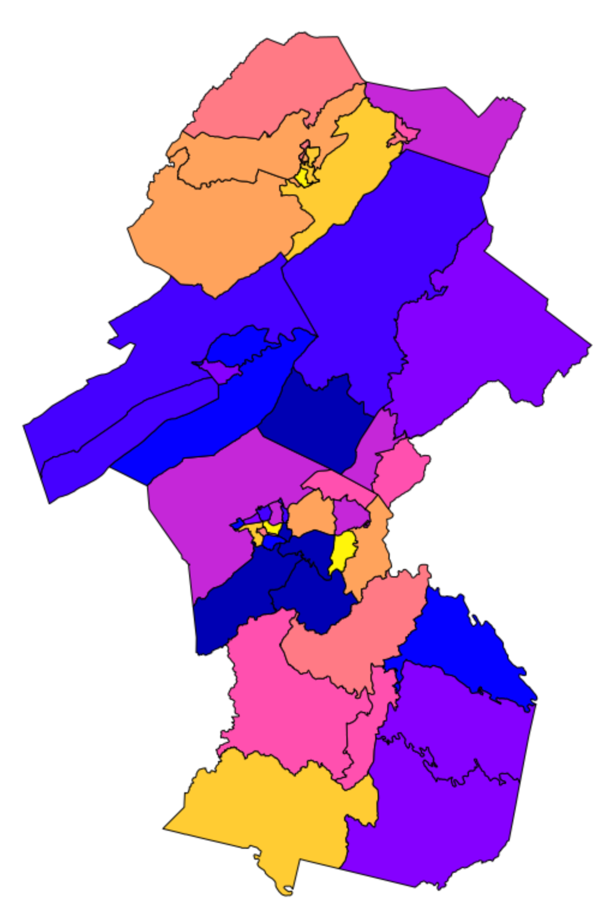
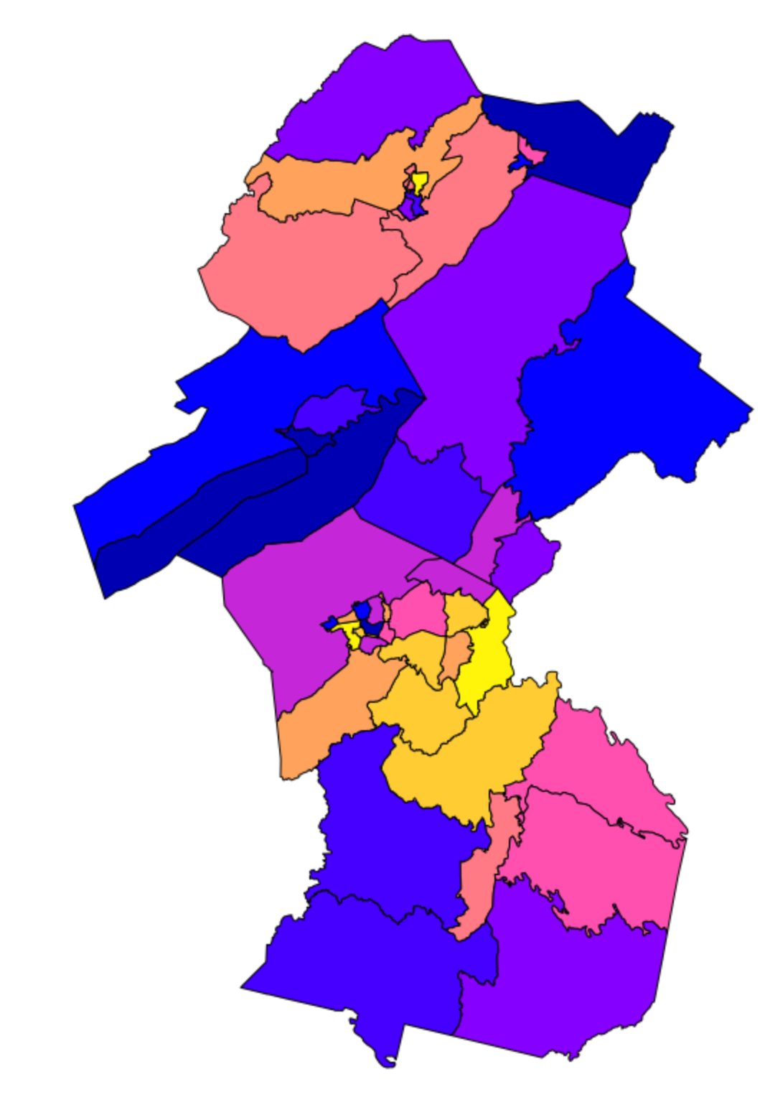
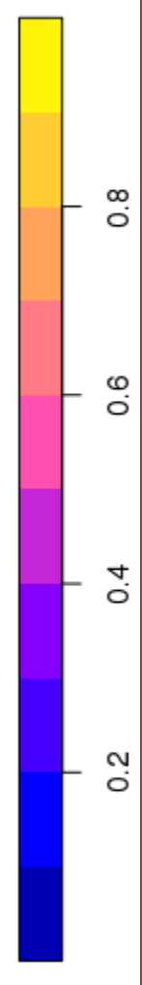
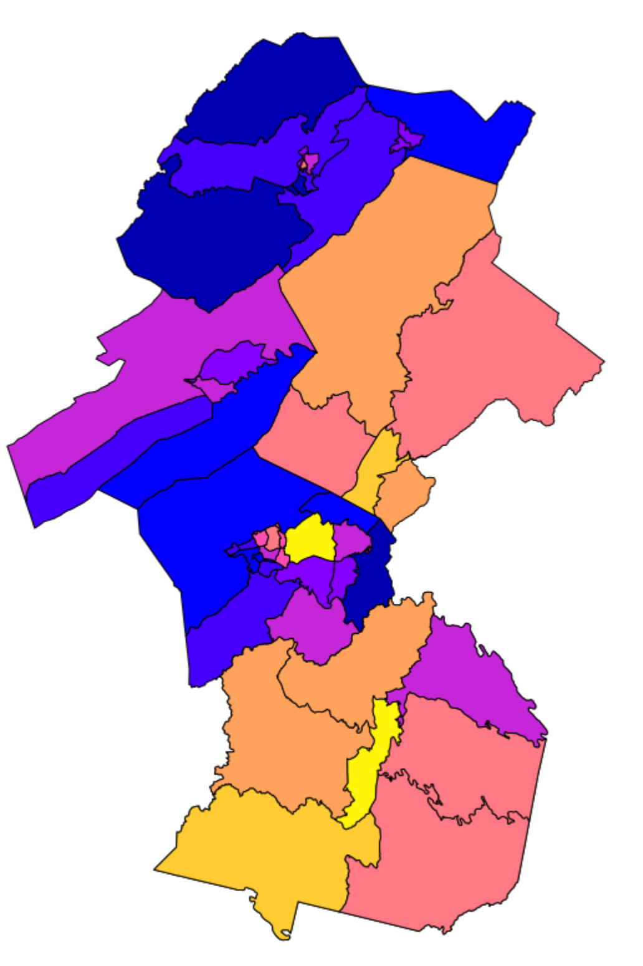
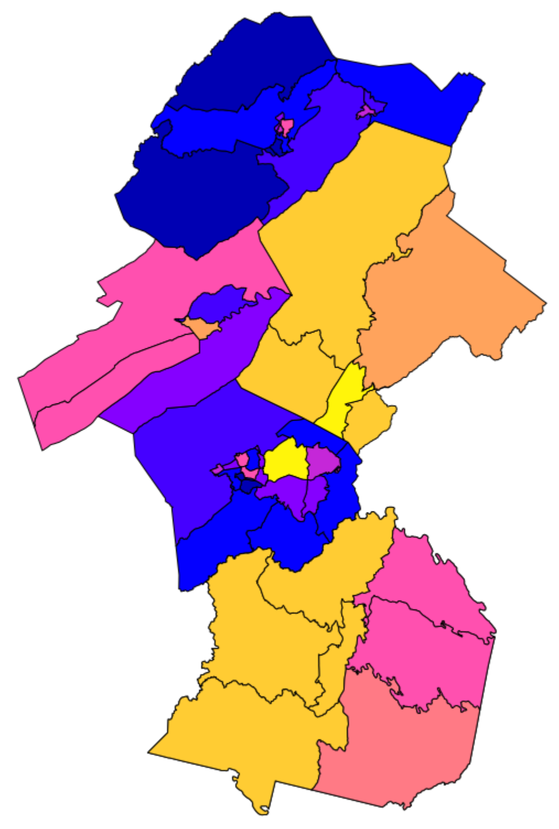
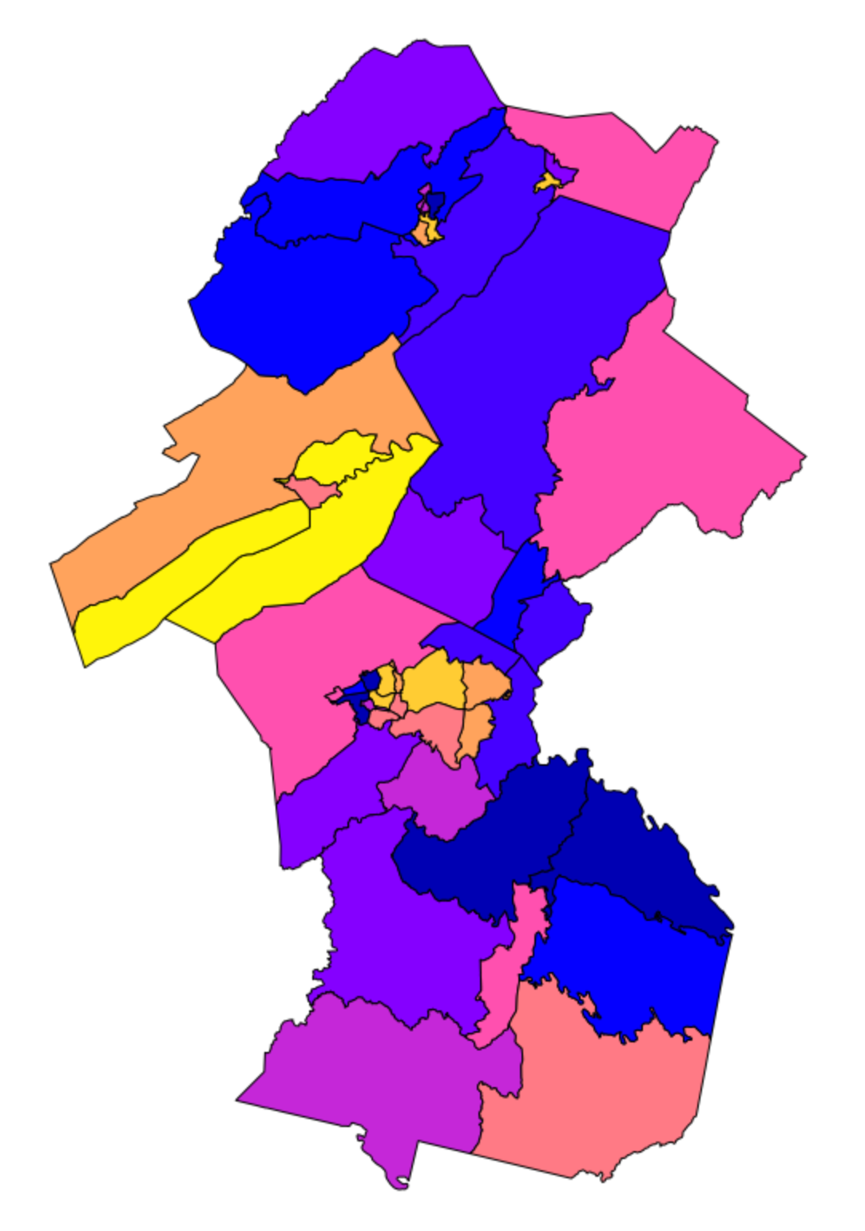
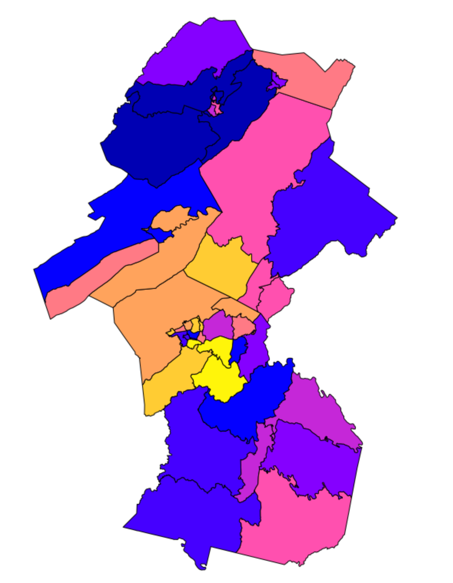
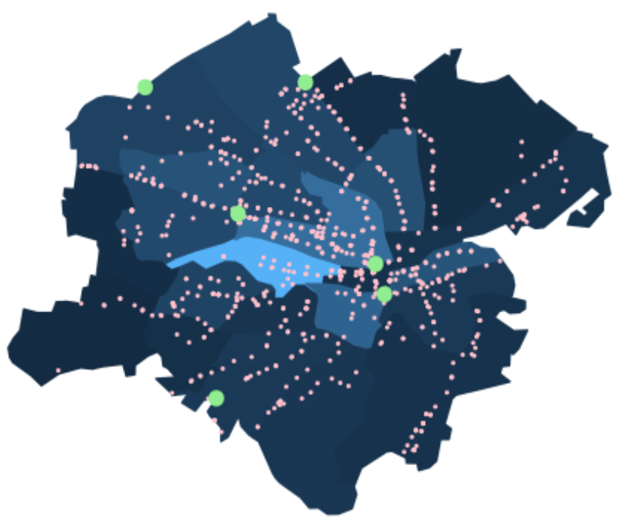
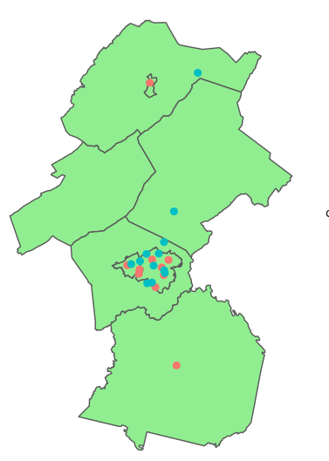
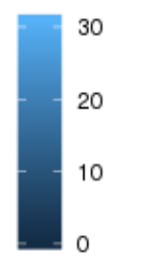







Roanoke Valley-Alleghany Region Attractiveness to Workers
Contributors: Davon Woodard, Eirik Iversen, Cory Kim, Doug Mattingly (Virginia Tech), Josh Goldstein and Stephanie Shipp (VT SDAL)
Sponsors: Wayne Strickland, Executive Director, Roanoke Valley-Alleghany Regional Commission
Project Overview and Goals
Data Discovery and Concept Mapping
Methods
Issue - Workforce Challenges, for example
Long Commutes
Mismatch of job openings & skills
Available child care
Affordable housing options
Objective: Create Demographic Profiles and Attractiveness Indicators to identify characteristics that appeal to retaining and recruiting a workforce to the region by County Magisterial Districts, City Election Districts, & Roanoke City quadrants
Develop American Community Survey (ACS) synthetic data to align to sub-county/sub-city geographic boundaries
Combine ACS microdata and summary tables to produce synthetic estimates by individual at new geographies, using Iterative Proportional Fitting technique
Re-compute summary statistics of those individuals by the 48 County Magisterial Districts, City Election boundaries, or Roanoke City quadrants
Create Demographic Profile and Attractiveness Indicators
Rank variables (see below) from 1 to 48
Sum ranks for each area & then normalize ranks from 0 to 1
Scrape data from internet
Public transportation routes and stops
Workforce development sites
Drug treatment facilities
Definition of attractiveness is adapted from Pattnaik, S., & Misra, R. (2014). Employer Attractiveness: A Conceptual Framework & Scale Development. Indian Journal of Industrial Relations, 50 (2), 318-327.
Demographic Profile Rankings and Attractiveness Indicators (by County Magisterial Districts or City Election Districts or Quadrants)
Where do the four worker populations live in the RVAR?
ATTRACTIVENESS VARIABLES
(% of population)
Transportation:
Commute Times (< 1 hr.)
Vehicle Ownership (own a vehicle)
Public Transportation (public transit is
primary means to work)
Housing:
Size of Home (Number of bedrooms)
Type of Home (Apartment/House)
Age of Home (Built before/after 1990)
Community:
Resident Type (Renter/Owner)
Family Presence (Family/NF Households)
Diversity (% non-white)
Employment (% employed)
Active Post-Secondary (enrolled in college)
(1) Single, ages 18-24,
No College Degree
(2) Single, ages 25-34,
College Degree
Areas more likely to live in
(3) Family, ages 35-49,
No College Degree
(4) Family, ages 35-49
College Degree
(5) Single Subpopulation Attractiveness Index
Higher
Attractiveness
(6) Family Subpopulation Attractiveness Index
Areas less likely to live in
Lower
Attractiveness
Sources: American Community Survey (synthetic data); GIS Shapefiles for each city and county in RVAR
Key Findings and Next Steps
Transportation Options
Drug Treatment/Workforce Facilities
Percent of Residents in Roanoke City WIthout Access to A Vehicle, by Census Tracts
Roanoke City:
Location of most workforce training centers
The only public transportation in region
Most residents in Roanoke City have access to a vehicle except those near city center (lighter blue areas)
Key Findings & Potential Policy Actions
Different household types live in different parts of the RVAR region, e.g. singles without a degree live in northwestern and southwestern parts while singles and families with college live closer to Roanoke city and surrounding areas (maps 1-4)
Attractiveness patterns across RVAR are similar for singles and families (maps 5-6)
  The northwest side of Roanoke City and western side of Franklin County have the highest attractiveness values for both singles and families; Botetourt County is very attractive to families
Transportation options are limited to vehicles for most residents in region; a larger percent of individuals in Craig and Franklin Counties have longer commutes (data not shown)
Next Steps
Examine underlying factors to identify policy options
Drug Treatment Facilities
Workforce Development Facilities (including colleges)
Workforce Development
Sources: American Community Survey, Roanoke Regional Partnership, Substance Abuse and Mental Health Services Administration (SAMHSA), Moveit.com
Bus Stops
facebook.com/biocomplexity
twitter.com/biocomplexityvt
youtube.com/c/biocomplexity
google.com/+biocomplexity
Acknowledgements
Stay Connected:

